Slide 1
CS311 – Project One
Your Name – Semester / Year
{ link to git repo }
{ link to live site }

Slide 2
Proposal

Slide 3
Purpose / topic
My site is a about a personal project I am starting with a friend of mine. The website is going to just be what is this website going to be. Essentially a website talking about another website how fun.. The concept behind the website is to make a space for comic artist to upload and share their in progress comics and books to upload to this editor where users can access others work when public, give suggestions and revisions of their own. It will allow the users to edit the comic to their needs and allow them to read it to them section

Slide 4
Content
I will find my content through myself and a lot of it will come from my friend who was the person who suggested this idea. I will be using this informational website as a formatter to how we would want the original website to be mapped out.

Slide 5
Site Map
A diagram of your site pages and how they connect to each other

Slide 6
Layout sketches
What will your site look like visually?

Slide 7
Discussion points
Will users understand where to navigate on the site?
What inspirations / resources did you use for the design?
Where is a good point to add interactivity into the site?
Where will you find your content? Will you have permission to use it?

Slide 8
Milestone 1

Slide 9
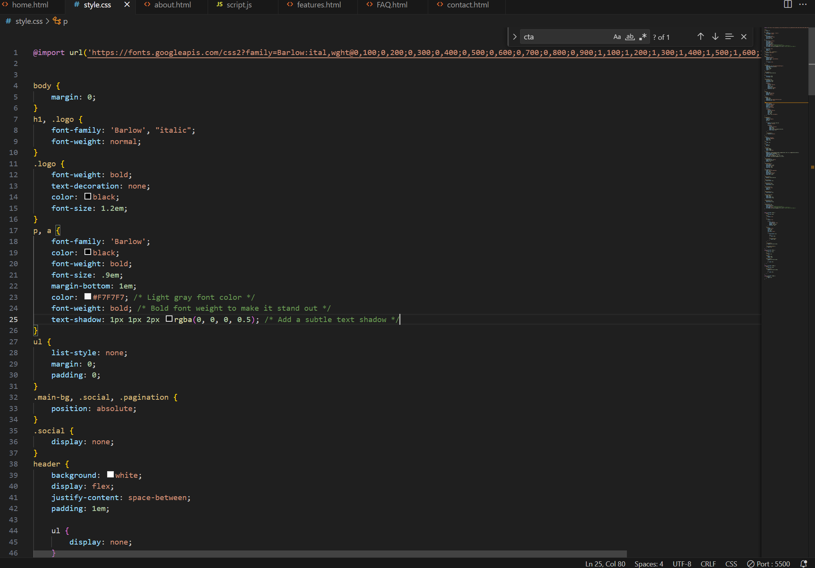
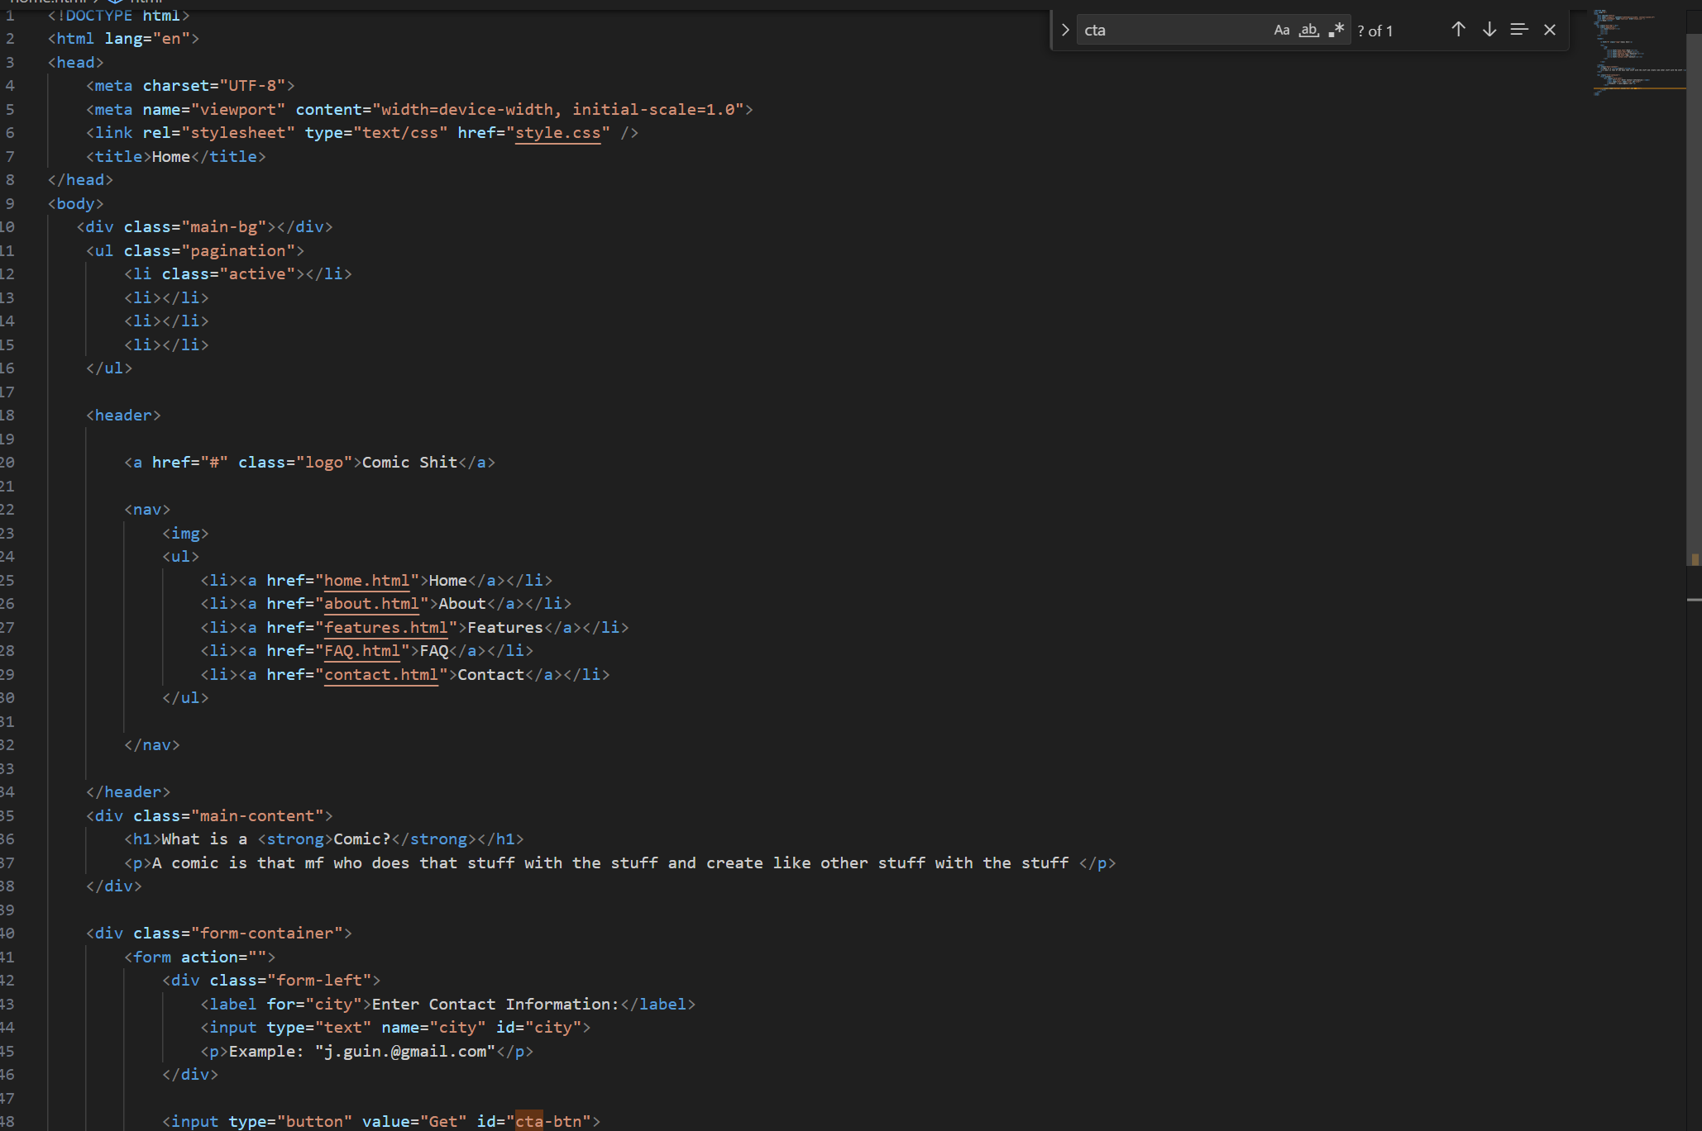
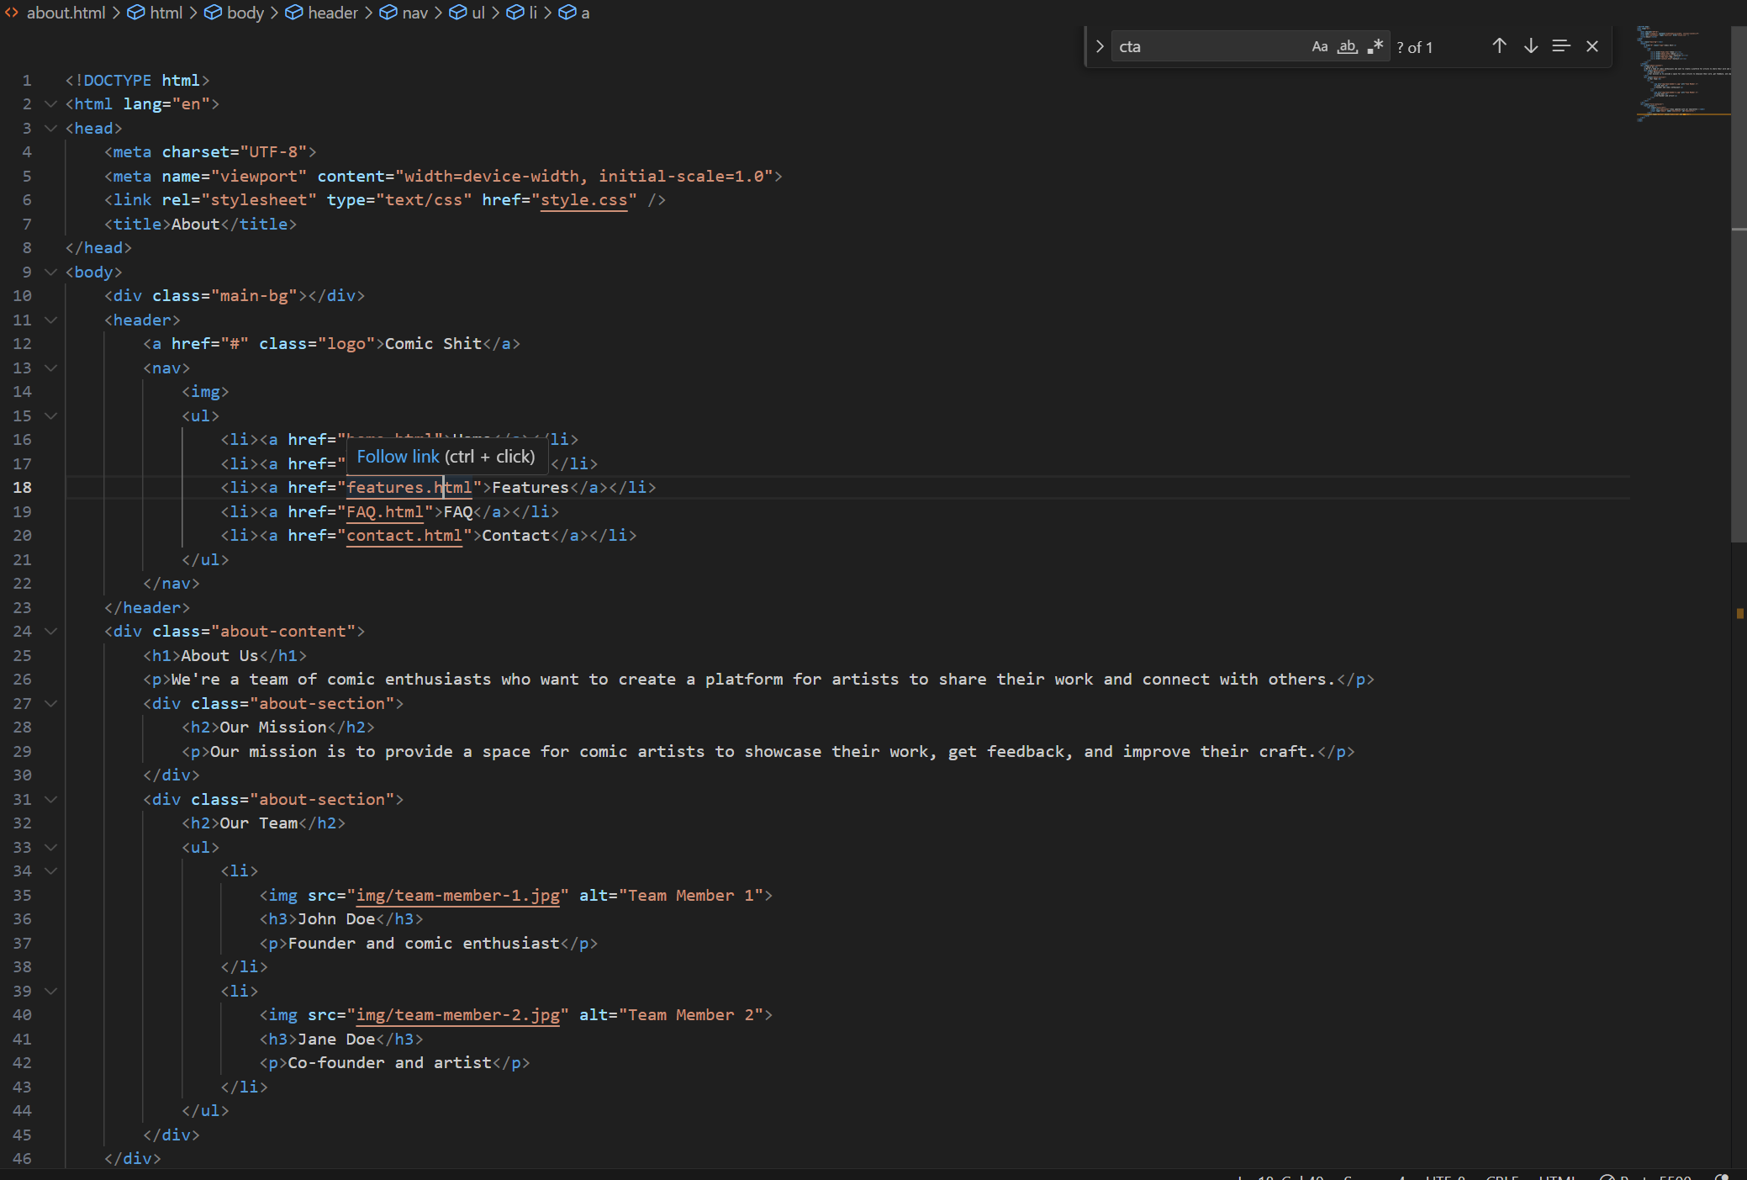
Screenshot of progress

Slide 10
Discussion
(delete these prompts, write what you talked about with a peer)
How does your markup change when making accessible pages?
I use tags such as nav, main, and section to provide a clear structure to the page making it easier for users to understand
What tension that accessibility and design introduce to your development?
Trying to find the correct fonts and colors that would be visually appealing to the user that is accessing my websites and just the correct CSS in general.
How does CSS change your approach to writing markup?
I use CSS to create responsive designs that adapt to different screen sizes and devices, making the page more accessible to users with different needs.
Where can you add interactivity?
I can add interactivity in the home page with css and js to add hover affects and different effects in the background to look more appealing

Slide 11
Reflection
Specific action items to work on next time
What are you struggling with
I am struggling with mapping out my websites I feel as if I spend to much time trying to draw out and get everything ready instead of testing out certain grids or flex boxes to see what works best for my website
Changes in plans after peer discussion

Slide 12
Self-assessment
Bold and highlight where you feel you fall
Site navigation Poor Acceptable High
Accessibility Poor Acceptable High
Site aesthetics Poor Acceptable High
CSS Applications Poor Acceptable High
JavaScript application Poor Acceptable High

Slide 13
Milestone 2

Slide 14
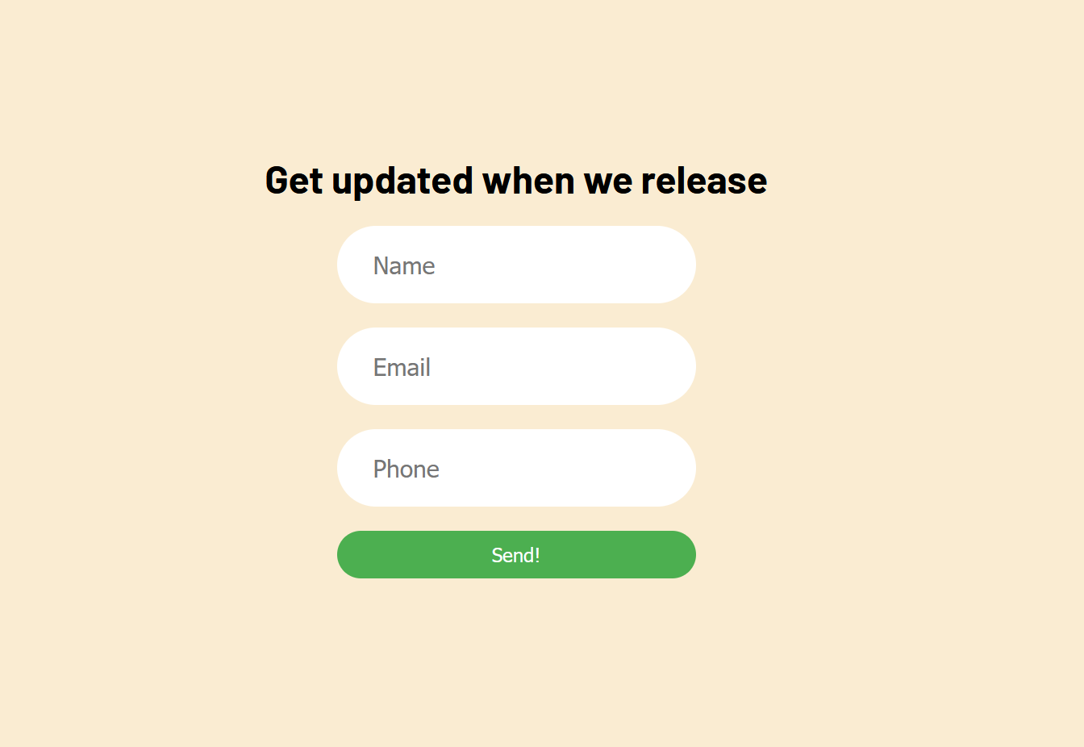
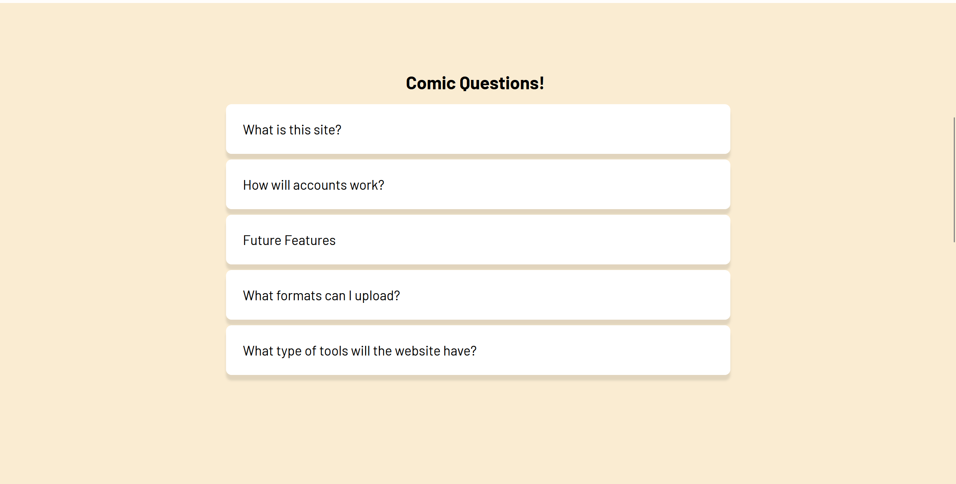
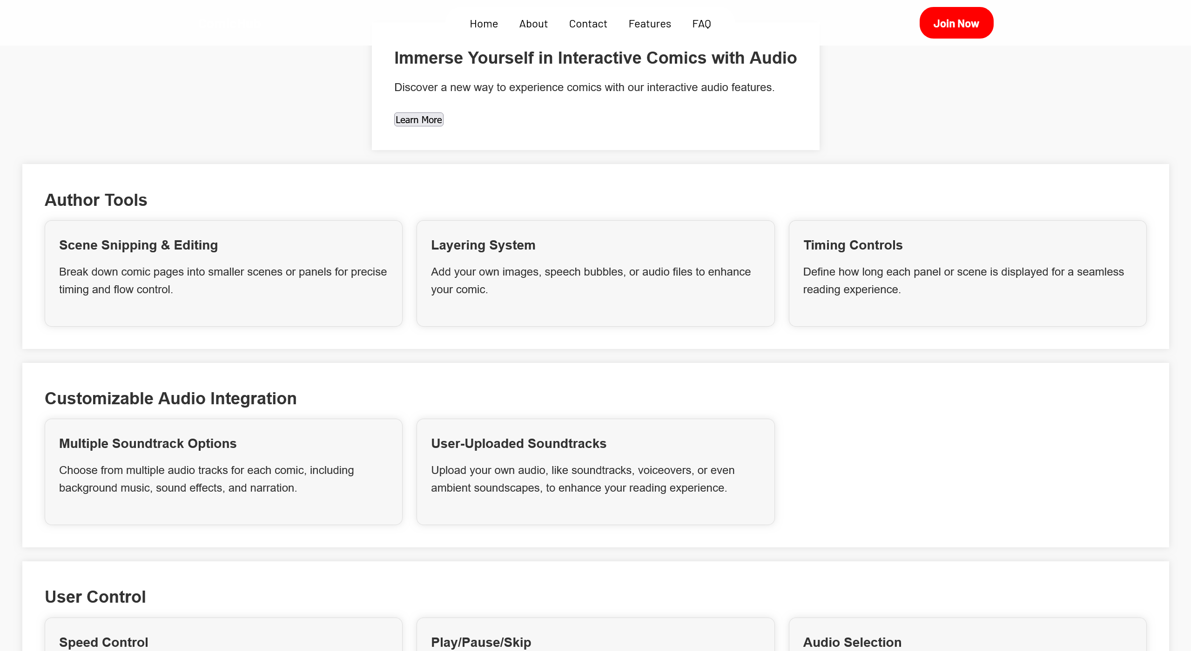
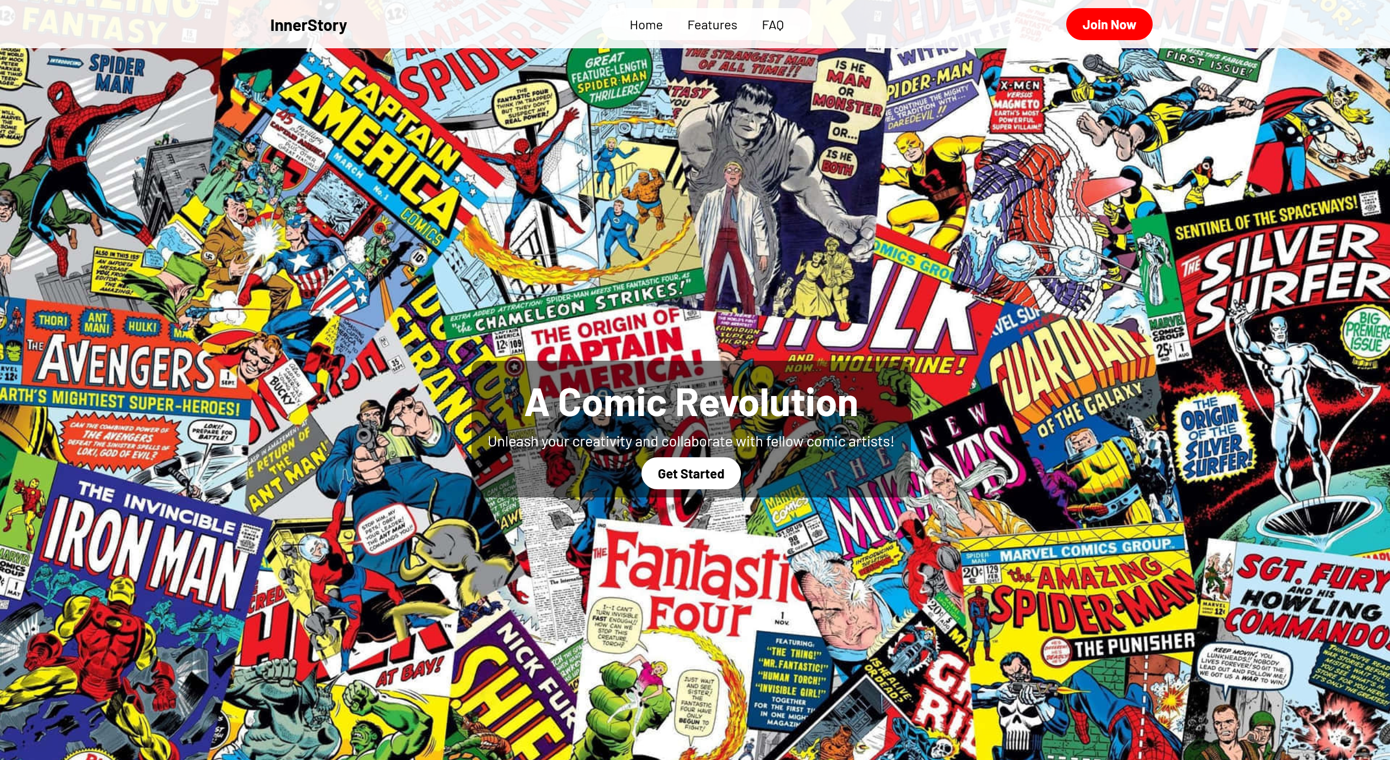
Screenshot of progress
Can be code or a page on your site

Slide 15
Discussion
How does adding content change the way you write markup?
It changes everything, with trying to add content I am thinking of new ideas which hinders me but also allows me to think about a lot of new ideas I would like to add with this website.
When adding interactivity, do you find yourself changing the layout of the page?
Of course, I find myself going back and changing the grid layout a lot when thinking of the interactivity I’d like to add.
Is interactivity accessible?
Yes the interactivity is accessible for the users to see and use such as the drop down boxes
When and why should you use interactive elements powered by JavaScript on your sites?
I think you should use interactive element when you want to make your website more engaging for the user, I think it adds a lot of new elements to the website. Why this is because it can make things look more pleasing for the user and allowing the user to move more freely through the website.

Slide 16
Reflection
Specific struggles
Trying to figure out what I want to do with each page, if I want to separate certain items, or if the grids look nice.
Plans for next week
About why, who we are
What is the website, specific features
Form for stuff
Changes in plans after peer discussion
Take the contact page make it its own page, create the following pages listed above for plans of next week. Add more javascript allowing the contact to take in information through a form.

Slide 17
Self-assessment
Bold and highlight where you feel you fall
Site navigation Poor Acceptable High
Accessibility Poor Acceptable High
Site aesthetics Poor Acceptable High
CSS Applications Poor Acceptable High
JavaScript application Poor Acceptable High

Slide 18
Final Reflection

Slide 19
Reflection
A few sentences on what you took away from this process. Specific skills or changes in outlook.

Slide 20
Self-assessment
Bold and highlight where you feel you fall
Site navigation Poor Acceptable High
Accessibility Poor Acceptable High
Site aesthetics Poor Acceptable High
CSS Applications Poor Acceptable High
JavaScript application Poor Acceptable High

